Slide 1


Introduction to Machine Learning Part 3: Standard Machine Learning algorithms
Jaume Bacardit
Interdisciplinary Computing and Complex BioSystems (ICOS) research group, School of Computing, Newcastle University
Jaume.Bacardit@Newcastle.ac.uk
Twitter: @jaumebp

Slide 2
Outline
In this lecture we will cover a few well-know machine learning algorithms
Decision Trees
Random Forests
Naïve Bayes
Nearest-neighbour Classifiers
Support Vector Machines
You will see through these examples different strategies on how to train models (i.e. search procedures for the appropriate model)
Before explaining decision trees I need to talk about information theory

Slide 3
Basic Information Theory
Shannon’s Entropy
Measure of the information content in discrete data
Metric inspired by statistical information transmission
“How many bits per symbol (in average) would it take to transmit a message given the frequencies of each symbol?”

Slide 4
Shannon’s Entropy
If we are tossing a coin and want to send a sequence of tosses
If heads and tails have the same probability it would take one bit per toss
If heads have a very small probability compared to tails we could just send a list of the heads and say that everything else is a tail
Each head message would be long, but there would be very few of them, so overall it would take less than one bit to transmit a symbol (in average).

Slide 5
Other information theory metrics
Conditional Entropy
Entropy of a certain variable given that we know all about a related variable
Information gain
How many bits would I save from transmitting Y if I know about X?
IG(Y|X) = H(Y) – H(Y|X)

Slide 6
Why is it useful for in data mining?
We have a continuous variable where each data point is associated to a class
10 red dots, 10 blue dots
H(X) = -(0.5log(0.5)+0.5log(0.5))=1
What if we split this variable in two?
Where to split?
The point where we obtain maximum IG. Conditional variable X is the splitting point

Slide 7
Different cut points
H(X;left) = 0.469, H(X;right) = 0.469, IG=0.531
H(X;left) = 0, H(X;right) = 0.863, IG=0.384
H(X;left) = 0.863, H(X;right)=0, IG=0.384

Slide 8
A decision tree
age?
<=30
overcast
>40
31..40
student?
yes
credit rating?
no
yes
excellent
fair
no
yes
no
yes
Some slides taken from “Jiawei Han, Data Mining: Concepts and Techniques. Chapter 6 “

Slide 9
Algorithm for Decision Tree Induction
Basic algorithm (a greedy algorithm)
Tree is constructed in a top-down recursive divide-and-conquer manner
At start, all the training examples are at the root
Attributes are categorical (if continuous-valued, they are discretized in advance)
Examples are partitioned recursively based on selected attributes
Test attributes are selected on the basis of a heuristic or statistical measure (e.g., information gain)
Conditions for stopping partitioning
All samples for a given node belong to the same class
There are no remaining attributes for further partitioning – majority voting is employed for classifying the leaf
There are no samples left

Slide 10
Attribute Selection Measure: Information Gain (ID3/C4.5)
Select the attribute with the highest information gain
Let p_{i} be the probability that an arbitrary tuple in D belongs to class C_{i}, estimated by |C_{i, D}|/|D|
Expected information (entropy) needed to classify a tuple in D:
Information needed (after using A to split D into v partitions) to classify D:
Information gained by branching on attribute A
Notes:
I : the expected information needed to classify a given sample
E (entropy) : expected information based on the partitioning into subsets by A

Slide 11
Attribute Selection: Information Gain
Class P: buys_computer = “yes”
Class N: buys_computer = “no”
means “age <=30” has 5 out of 14 samples, with 2 yes’es and 3 no’s. Hence
Similarly,

Slide 12
Grain Ratio, Overfitting and Tree Pruning
Information gain measure is biased towards attributes with a large number of values
Need to normalise it before comparing across heterogeneous attributes
Overfitting: An induced tree may overfit the training data
Too many branches, some may reflect anomalies due to noise or outliers
Poor accuracy for unseen samples
Two approaches to avoid overfitting
Prepruning: Halt tree construction early—do not split a node if this would result in the goodness measure falling below a threshold
Difficult to choose an appropriate threshold
Postpruning: Remove branches from a “fully grown” tree—get a sequence of progressively pruned trees
Use a set of data different from the training data to decide which is the “best pruned tree”

Slide 14
Random Forest
An algorithm that derives from the decision trees, and one of the most popular nowadays
It applies a ML approach called ensemble learning
What if we don’t train a single model but many, we ask all of them to make predictions, and the overall decision is the majority vote of all models?
Wouldn’t all constructed trees be the same and hence vote in the same way?
For ensemble methods to work well they must induce diversity within the set of models
How RF induces diversity?
Each tree is trained from a bootstrap sample of the training set
A sample, with replacement, from the training set of same size (~63.2% of unique examples)
Each tree can only use a randomly chosen subset of the set of attributes
By default sqrt(#num atts)
Typically the gini impurity is used as split criteria when building trees
Breiman, “Random Forests”, Machine Learning, 45(1), 5-32, 2001.

Slide 15
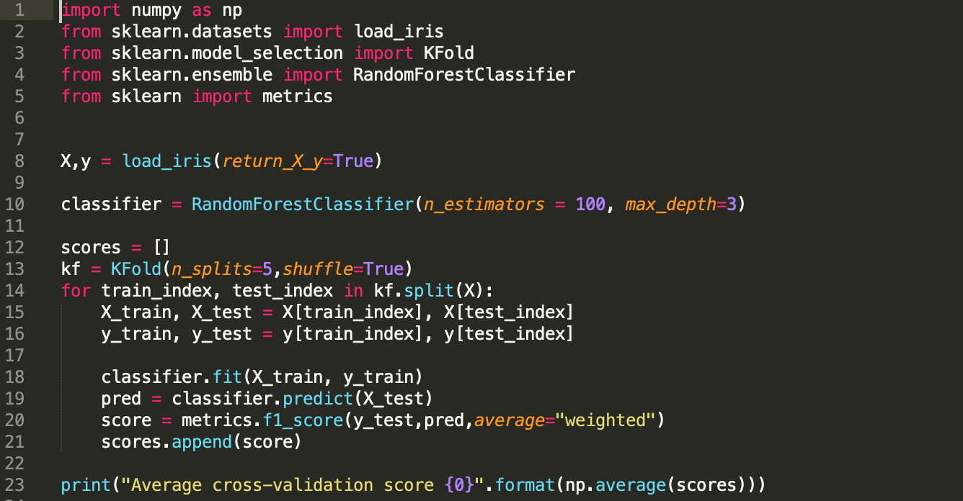

Slide 16
Bayesian Theorem: Basics
A statistical classifier: performs probabilistic prediction, i.e., predicts class membership probabilities
Let X be a data sample (“evidence”): class label is unknown
Let H be a hypothesis that X belongs to class C
Classification is to determine P(H|X), the probability that the hypothesis holds given the observed data sample X
P(H) (prior probability), the initial probability
E.g., X will buy computer, regardless of age, income, …
P(X): probability that sample data is observed
P(X|H) (posteriori probability), the probability of observing the sample X, given that the hypothesis holds
E.g., Given that X will buy computer, the prob. that X is 31..40, medium income

Slide 17
Bayesian Theorem
Given training data X, posteriori probability of a hypothesis H, P(H|X), follows the Bayes theorem
Informally, this can be written as
posteriori = likelihood x prior/evidence
Predicts X belongs to C₂ iff the probability P(C_{i}|X) is the highest among all the P(C_{k}|X) for all the k classes
Practical difficulty: require initial knowledge of many probabilities, significant computational cost

Slide 18
Towards Naïve Bayesian Classifier
Let D be a training set of tuples and their associated class labels, and each tuple is represented by an n-D attribute vector X = (x₁, x₂, …, x_{n})
Suppose there are m classes C₁, C₂, …, C_{m}.
Classification is to derive the maximum posteriori, i.e., the maximal P(C_{i}|X)
This can be derived from Bayes’ theorem
Since P(X) is constant for all classes, only
needs to be maximized

Slide 19
Derivation of Naïve Bayes Classifier
A simplified assumption: attributes are conditionally independent (i.e., no dependence relation between attributes):
This greatly reduces the computation cost: Only counts the class distribution
If A_{k} is categorical, P(x_{k}|C_{i}) is the # of tuples in C_{i} having value x_{k} for A_{k} divided by |C_{i, D}| (# of tuples of C_{i} in D)
If A_{k} is continous-valued, P(x_{k}|C_{i}) is usually computed based on Gaussian distribution with a mean μ and standard deviation σ

Slide 20
Naïve Bayesian Classifier: Training Dataset
Class:
C1:buys_computer = ‘yes’
C2:buys_computer = ‘no’
Data sample
X = (age <=30,
Income = medium,
Student = yes
Credit_rating = Fair)

Slide 21
Naïve Bayesian Classifier: An Example
P(C_{i}): P(buys_computer = “yes”) = 9/14 = 0.643
P(buys_computer = “no”) = 5/14= 0.357
Compute P(X|C_{i}) for each class
P(age = “<=30” | buys_computer = “yes”) = 2/9 = 0.222
P(age = “<= 30” | buys_computer = “no”) = 3/5 = 0.6
P(income = “medium” | buys_computer = “yes”) = 4/9 = 0.444
P(income = “medium” | buys_computer = “no”) = 2/5 = 0.4
P(student = “yes” | buys_computer = “yes) = 6/9 = 0.667
P(student = “yes” | buys_computer = “no”) = 1/5 = 0.2
P(credit_rating = “fair” | buys_computer = “yes”) = 6/9 = 0.667
P(credit_rating = “fair” | buys_computer = “no”) = 2/5 = 0.4
X = (age <= 30 , income = medium, student = yes, credit_rating = fair)
P(X|C_{i}) : P(X|buys_computer = “yes”) = 0.222 x 0.444 x 0.667 x 0.667 = 0.044
P(X|buys_computer = “no”) = 0.6 x 0.4 x 0.2 x 0.4 = 0.019
P(X|C_{i})*P(C_{i}) : P(X|buys_computer = “yes”) * P(buys_computer = “yes”) = 0.028
P(X|buys_computer = “no”) * P(buys_computer = “no”) = 0.007
Therefore, X belongs to class (“buys_computer = yes”)

Slide 22
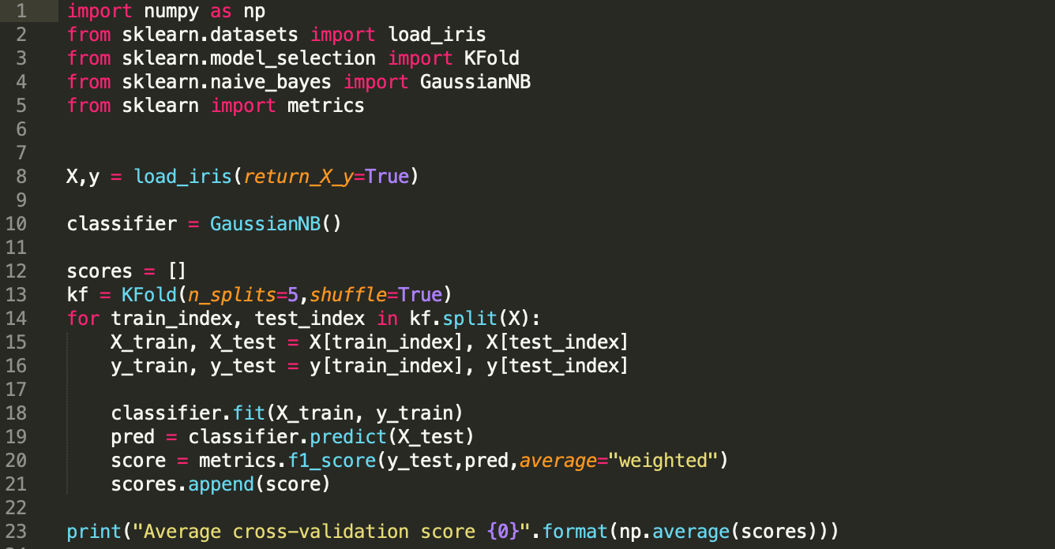

Slide 23
Instance-based Learning
Does not generate a model. It uses the training set (sometimes filtered; see the instance selection lecture) instead
k-NN machine learning algorithm:
Given an unlabeled new instance
Select the k instances from the training set most similar to the new instance
What is similar? (next slide)
Predict the majority class from these k instances

Slide 24
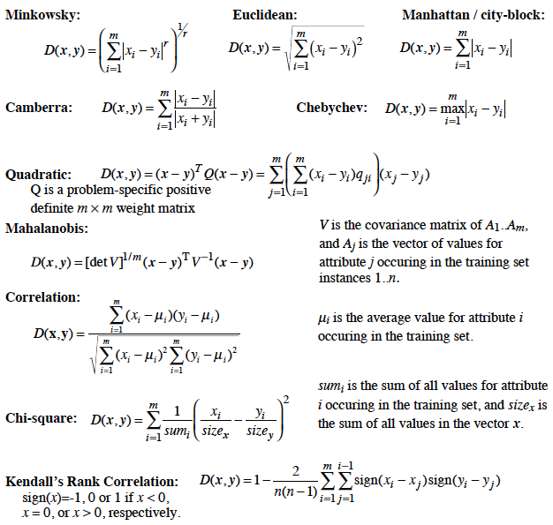
Distance functions
Crucial for the performance of these methods
Sometimes weights are added to the distance functions to reflect the importance of the attributes

Slide 25
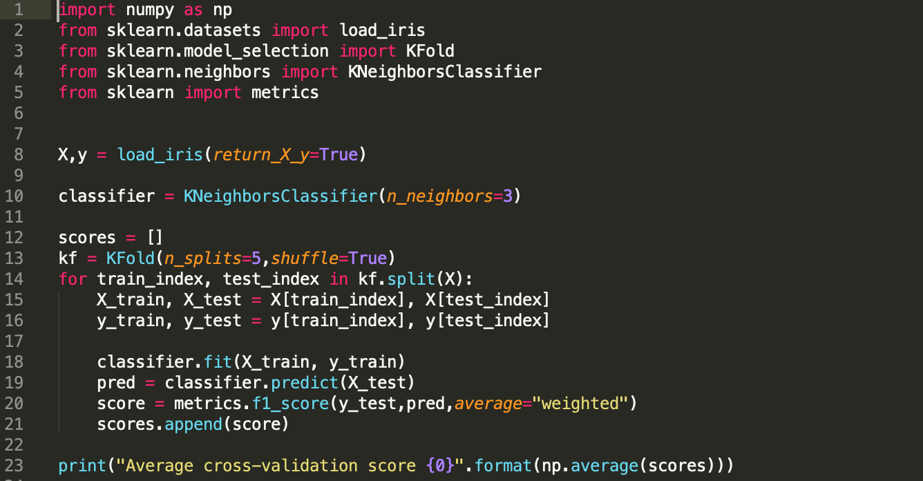

Slide 26
Classification: A Mathematical Mapping
Classification:
predicts categorical class labels
Mathematically
x ∈ X = ℜ^{n}, y ∈ Y = {+1, –1}
We want a function f: X → Y
x
x
x
x
x
x
x
x
o
x
o
x
o
o
o
o
o
o
o
o
o
o
o

Slide 27
SVM—Support Vector Machines
A classification method for both linear and nonlinear data
It uses a nonlinear mapping to transform the original training data into a higher dimension
With the new dimension, it searches for the linear optimal separating hyperplane (i.e., “decision boundary”)
With an appropriate nonlinear mapping to a sufficiently high dimension, data from two classes can always be separated by a hyperplane
SVM finds this hyperplane using support vectors (“essential” training tuples) and margins (defined by the support vectors)

Slide 28
SVM—General Philosophy
Small Margin
Large Margin
Support Vectors

Slide 29
SVM—Linearly Separable
A separating hyperplane can be written as
W ● X + b = 0
where W={w₁, w₂, …, w_{n}} is a weight vector and b a scalar (bias)
For 2-D it can be written as
w₀ + w₁ x₁ + w₂ x₂ = 0
The hyperplane defining the sides of the margin:
H₁: w₀ + w₁ x₁ + w₂ x₂ ≥ 1 for y_{i} = +1, and
H₂: w₀ + w₁ x₁ + w₂ x₂ ≤ – 1 for y_{i} = –1
Any training tuples that fall on hyperplanes H₁ or H₂ (i.e., the sides defining the margin) are support vectors
This becomes a constrained (convex) quadratic optimization problem
Formulas in the next slides taken from http://en.wikipedia.org/wiki/Support_vector_machine

Slide 30
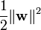
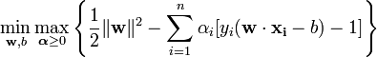
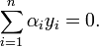
Linear SVMs: basic formulation
Original formulation
Minimise subject to for each training example i from 1..n
Using Lagrangian multipliers
Using the dual formulation
Maximise
subject to and
Kernel. In its original formulation a dot product.

Slide 31
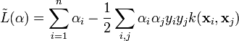
Linear SVMs: Soft Margin
Allow some points to be on the wrong side of the hyperplane.
A new parameter C is introduced to control the maximum allowable sum of errors.
Dual formulation
Maximise
subject to and

Slide 32
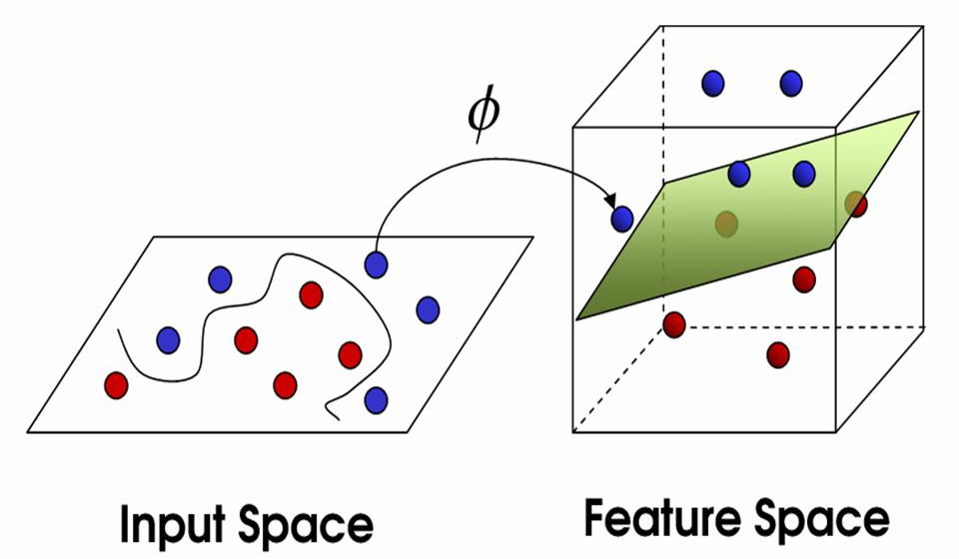
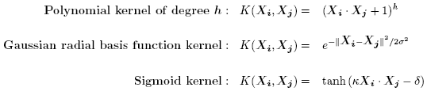
SVM—non-linear classification & kernel functions
Transform the original input data into a higher dimensional space
Search for a linear separating hyperplane in the new space
Instead of computing the dot product on the transformed data tuples, it is mathematically equivalent to instead applying a kernel function K(Xi, Xj) to the original data, i.e., K(Xi, Xj) = Φ(Xi) Φ(Xj)
Typical Kernel Functions
SVM can also be used for classifying multiple (> 2) classes and for regression analysis (with additional user parameters)

Slide 33
